Slide 1

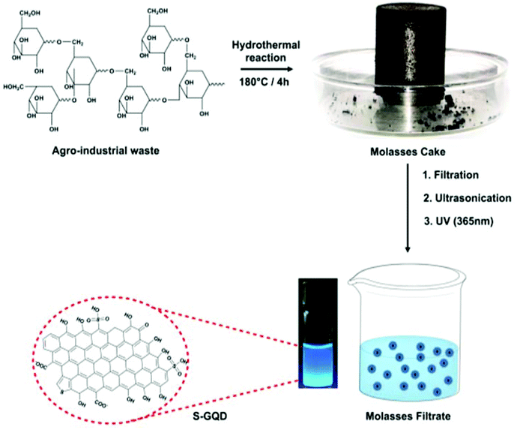
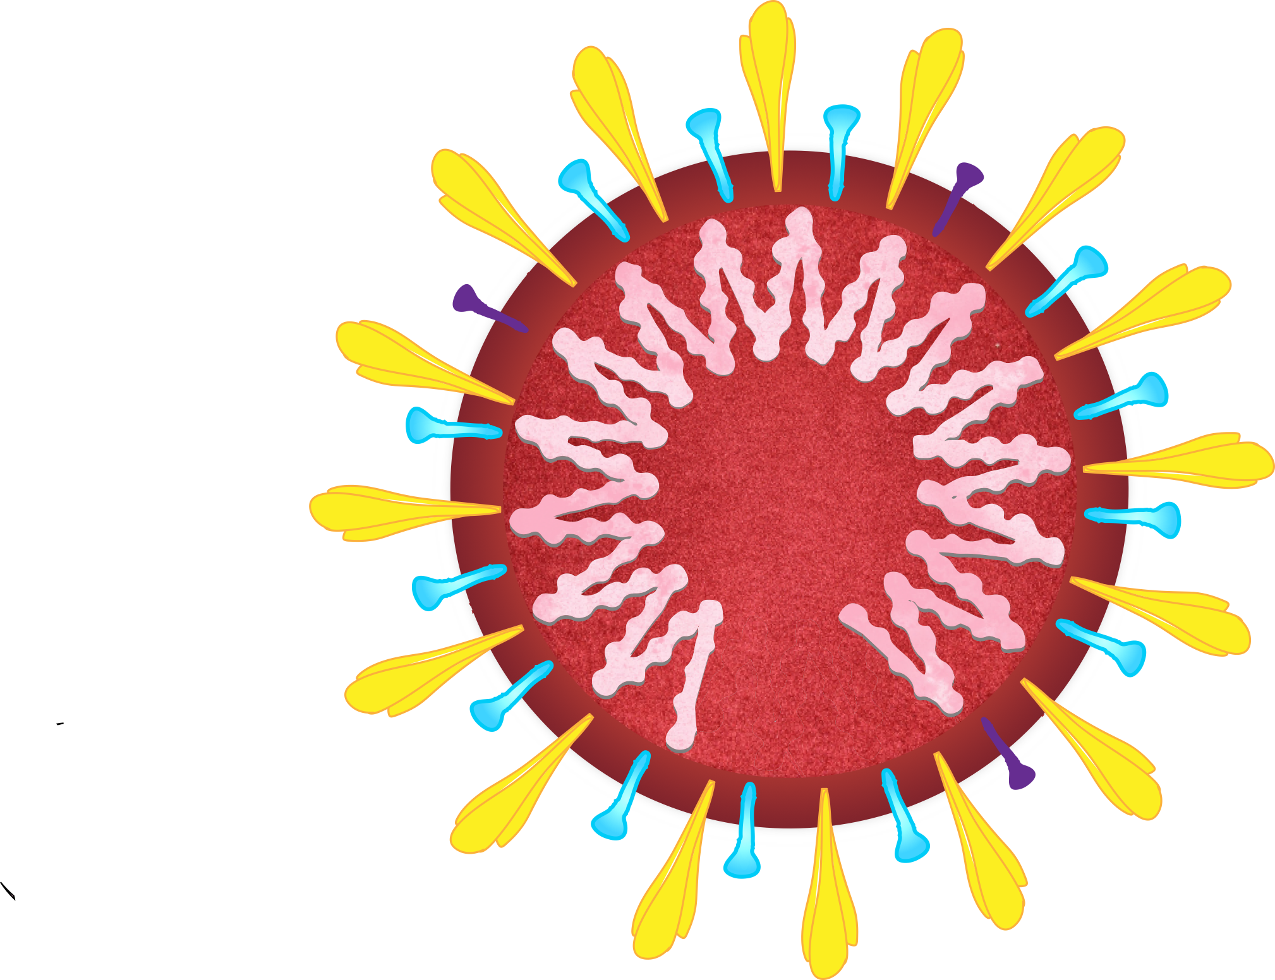
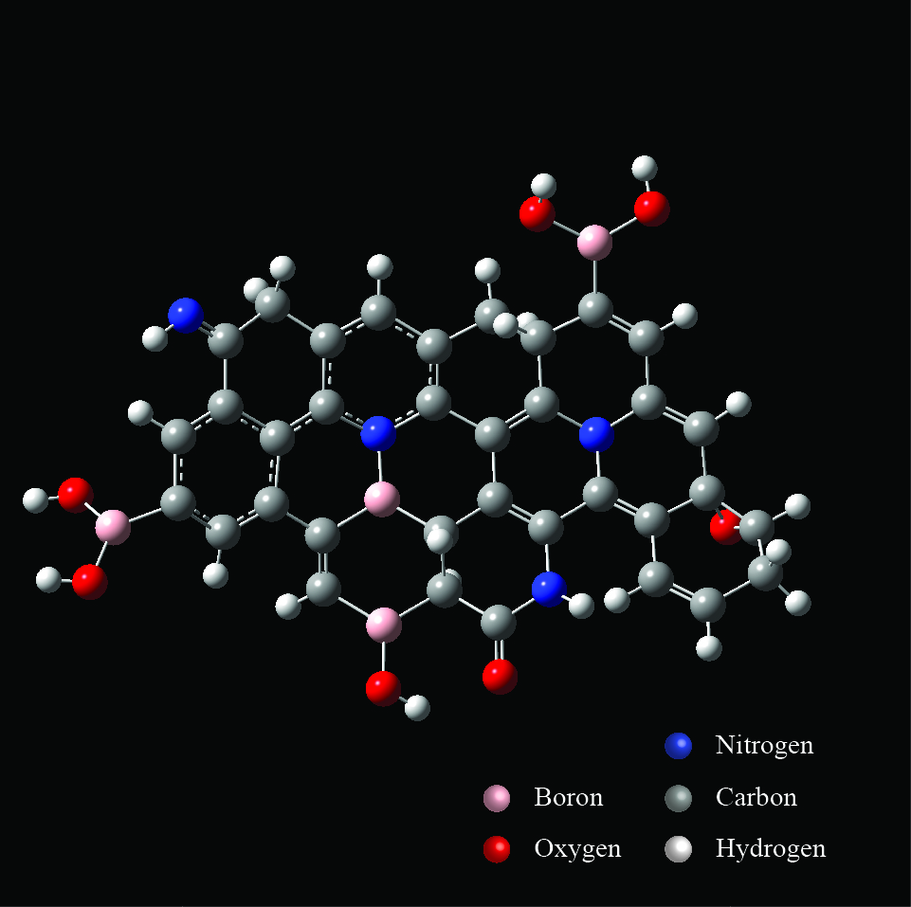
Carbon nanomaterials to combat the novel coronavirus
Independent Research Study
Siddhartha Pahari
Research Intern
Amity Institute of Click Chemistry Research and Studies
Under the guidance of
Dr. Chirantan Kar
Chemistry Department
Amity University Kolkata (AUK)
Faculty Coordinator

Slide 2
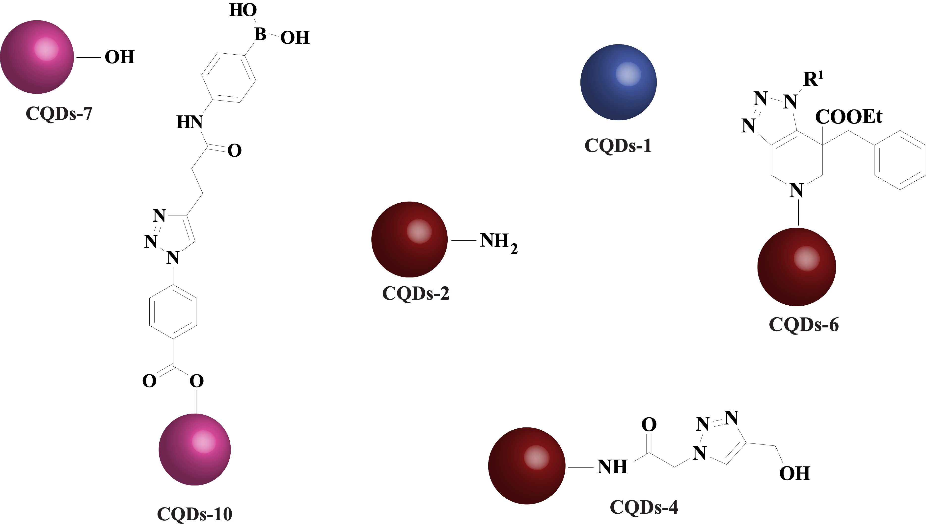
Rationale behind our work
Due to the presence of sp³ hybridized carbons in CQDs, they are much more prone towards surface functionalization by click chemistry. Moreover, doping plays a crucial role.
+
Recently, triazole derivatives have been explored as potent inhibitors of human coronaviruses by blocking the viral enzymes such as 3-chymotrypsin-like protease (3CLpro) and helicase, important for viral replication.
=
Synergistic antiviral effect
Triazole functionalized heteroatom co-doped carbon quantum dots
(TFH-CQDs)
Zaher et al. Acta Pharm. 2020
Łoczechin et al. ACS Appl. Mater. Interfaces 2019

Slide 3
Graphical Abstract
CQDs-based bioisosteres (chemical groups having similar physical and chemical properties with broadly similar type of biological activity)

Slide 4
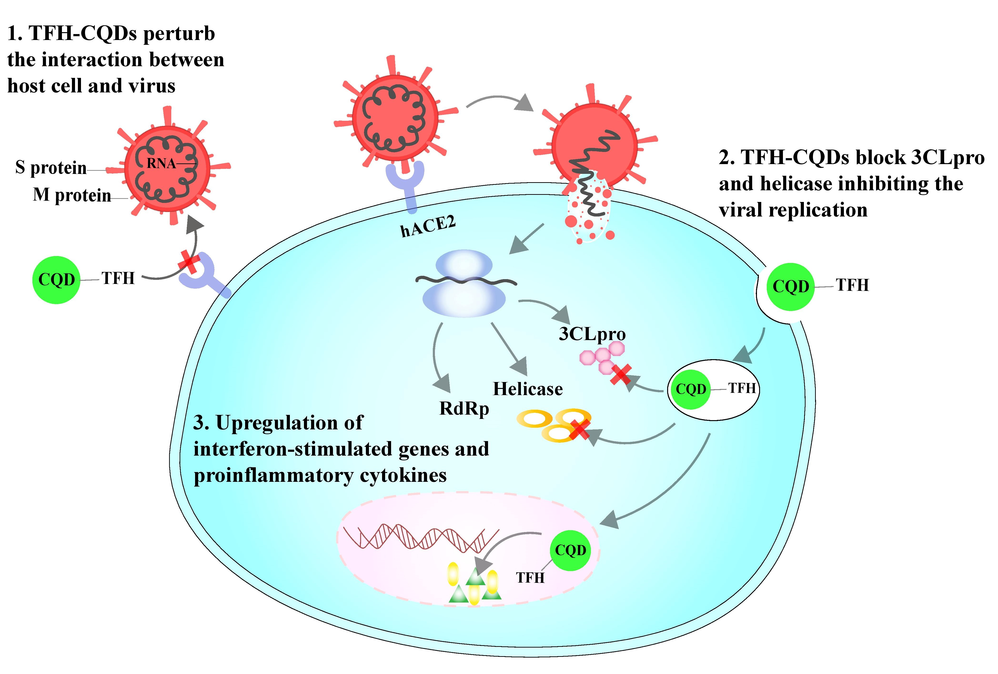
Abstract: Highlights
• CQDs can act as a multi-site inhibitor by blocking the viral entry, RNA strand synthesis, and replication step.
• TFH-CQDs can synergistically exert an intensified antiviral response.
• TFH-CQDs may block the viral entry by perturbing various interactions with the host cells.
• TFH-CQDs may block the viral enzymes such as helicase and 3CLpro, important for viral replication.
• Understanding the receptor recognition mechanism of human coronaviruses with host cells is imperative to elucidate the inhibitory mechanism of TFH-CQDs

Slide 5
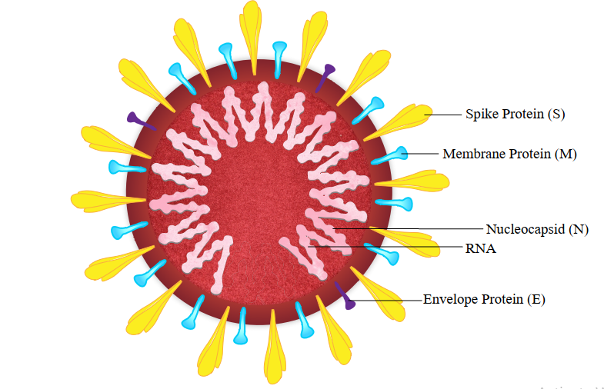
Introduction: Problem Statement
The world is facing the potential catastrophe of a global pandemic due to the rapid surge in the number of people being infected with the novel human coronavirus i.e. SARS-CoV-2, leaving the world in dire need of possible cure regimens and effective therapies.

Slide 6
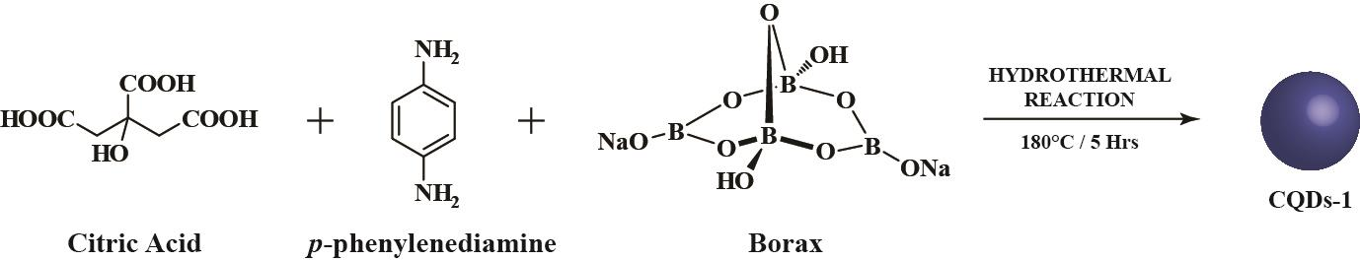
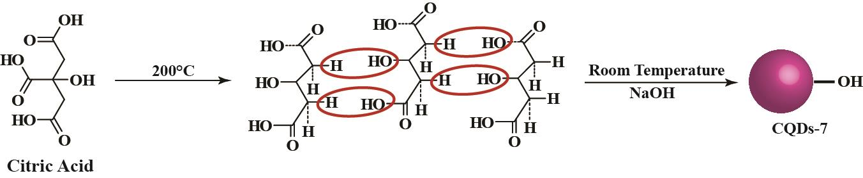
Our methodology
Our proposed route for the synthesis of heteroatom doped CQDs:
Scheme 1 The proposed hydrothermal route of heteroatom co-doped CQDs-1 from citric acid, p-phenylenediamine and borax as precursors.
Scheme 2 The proposed hydrothermal route for CQDs-7 using citric acid as precursor

Slide 7
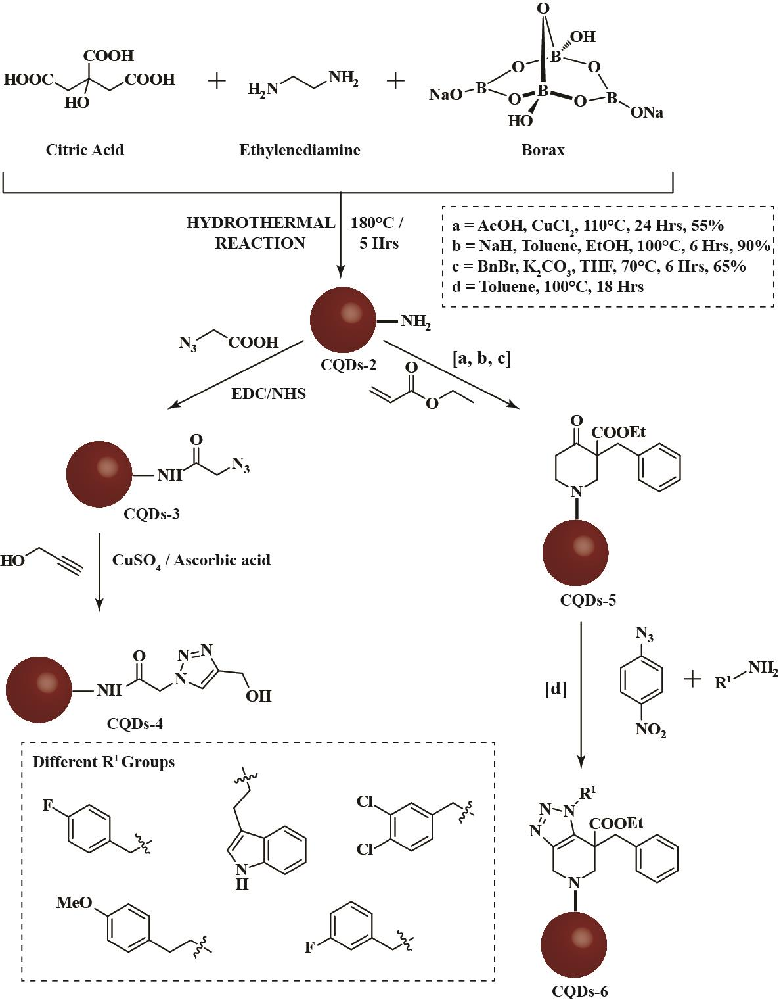
Our methodology
Scheme 3 The proposed hydrothermal route for heteroatom co-doped CQDs 2 from citric acid, ethylenediamine, and borax as precursors. CQDs-2 functionalized with triazole moiety via click chemistry giving rise to TFH-CQDs-4.
Plausible pathway for the formation of CQDs-6 from CQDs-2 with a variable R¹ group (as shown in the inset).
Karypidou et al. Bioorg. Med. Chem. Lett. 2018

Slide 8
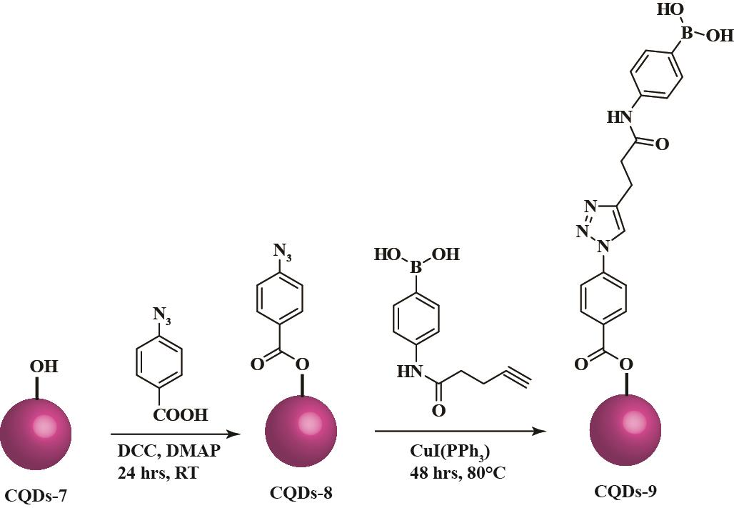
Our methodology
Scheme 4 The proposed route for the formation of CQDs-9 with boronic acid as a functional group via click chemistry

Slide 9
Proposed inhibitory mechanisms using TFH-CQDs

Slide 10
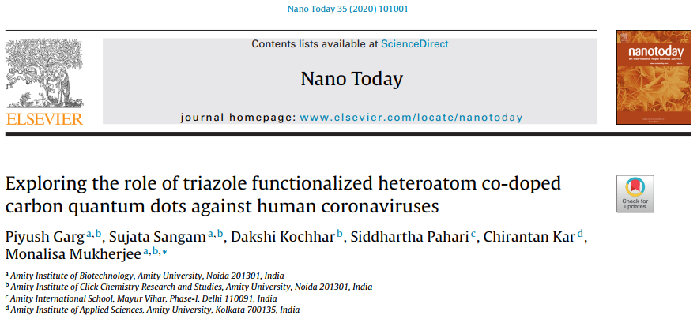
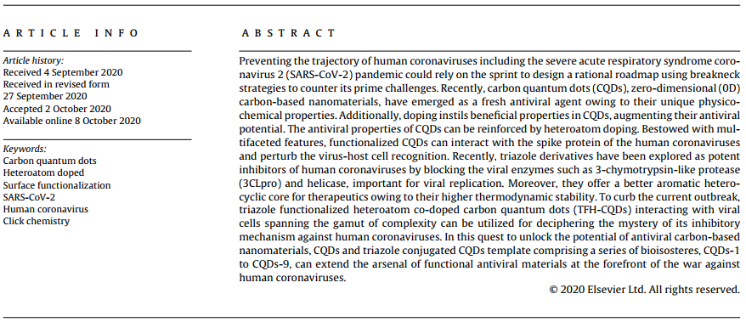
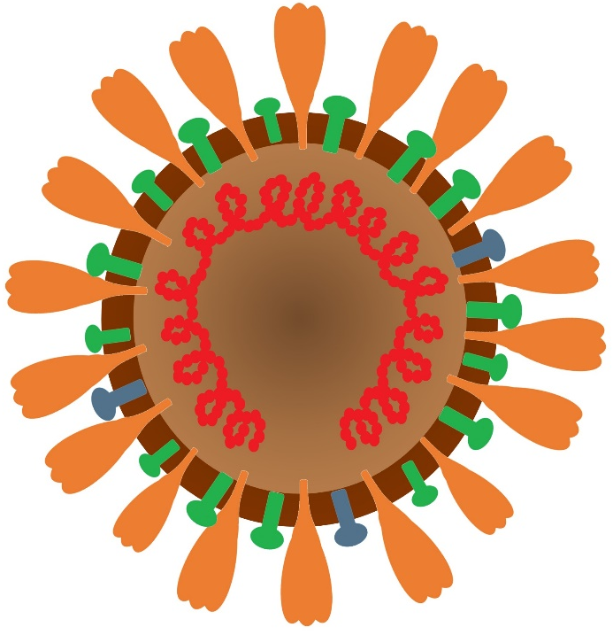
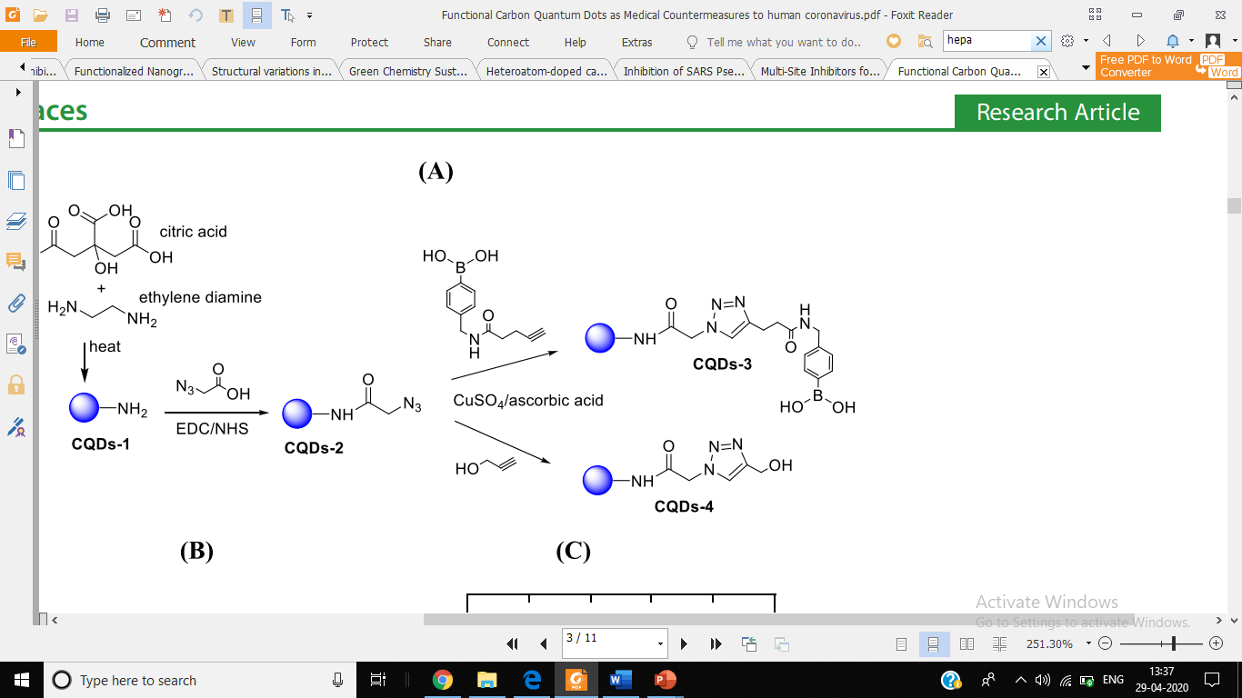
Outcomes of the work
Garg, P.; Sangam, S.; Kochhar, D.; Pahari, S.; Kar, C.; Mukherjee, M. “Exploring the role of triazole functionalized heteroatom co-doped carbon quantum dots against human coronaviruses” Nano Today, 2020, Impact factor: 16.9
[https://doi.org/10.1016/j.nantod.2020.101001]

Slide 11

References
N.H. Zaher, M.I. Mostafa, A.Y. Altaher, Design, synthesis and molecular docking of novel triazole derivatives as potential CoV helicase inhibitors, Acta Pharm. 70 (2020) 145–159, http://dx.doi.org/10.2478/acph-2020-0024.
K. Karypidou, S.R. Ribone, M.A. Quevedo, L. Persoons, C. Pannecouque, C. Helsen, F. Claessens, W. Dehaen, Synthesis, biological evaluation and molecular modeling of a novel series of fused 1, 2, 3-triazoles as potential anti-coronavirus agents, Bioorg. Med. Chem. Lett. 28 (2018) 3472–3476, http://dx.doi.org/10.1016/j.bmcl.2018.09.019
A. Łoczechin, K. Seron, ´ A. Barras, E. Giovanelli, S. Belouzard, Y. Chen, N. Metzlernolte, R. Boukherroub, J. Dubuisson, S. Szunerits, Functional carbon quantum dots as medical countermeasures to human coronavirus, ACS Appl. Mater. Interfaces 11 (2019) 42964–42974, http://dx.doi.org/10.1021/acsami.9b15032.
T. Du, J. Liang, N. Dong, L. Liu, L. Fang, S. Xiao, H. Han, Carbon dots as inhibitors of virus by activation of type I interferon response, Carbon N. Y. 110 (2016) 278–285, http://dx.doi.org/10.1016/j.carbon.2016.09.032

Slide 12

Questions???

